Slide 1


ADICHUNCHANAGIRI UNIVERSITY
FACULTY OF ENGINEERING, MANAGEMENT &TECHNOLOGY
BGS INSTITUTE OF TECHNOLOGY
BG Nagara – 571448, Nagamangala Taluk, Mandya District, Karnataka (INDIA)
A Project Presentation
on “CropSafe : Navigating Storage Space For Farmers Using AI”
Submitted by:
Gurukiran K L (20CSE020)
Harshith Gowda P (20CSE022)
Hemanth Y D (20CSE026)
Manoj V (20CSE044)
Under the guidance of:
Mrs. Sahana D Gowda
Assistant Professor
Dept. of CS&E
BGSIT, BG Nagara, Mandya

Slide 2
CONTENTS
Abstract
Introduction
Problem Statement
Objectives
Literature Survey
Hardware and Software requirements
Existing System
Proposed System
System analysis and Design
Implementation
Testing
Results And Snapshots
Conclusion
Future Enhancement
References

Slide 3
ABSTRACT
This project introduces a method that harnesses the power of Artificial Intelligence (AI) to address two critical challenges in agriculture: reducing the cost of cold storage facilities and providing farmers with real-time knowledge about the prices of their crops. The implementation of AI technologies offers innovative solutions to enhance efficiency, reduce wastage, and empower farmers with valuable market insights.

Slide 4
INTRODUCTION
The agricultural sector faces global challenges such as ensuring food security, reducing post-harvest losses, and improving the livelihoods of millions of farmers worldwide.
Traditional cold storage systems for preserving perishable crops can be inefficient and costly due to fixed operating parameters.
Enhance cold storage efficiency using AI for dynamic temperature control and predictive maintenance, cutting energy use and operational expenses.

Slide 5
PROBLEM STATEMENT
AI can create user-friendly apps for farmers, offering real-time market insights to help them navigate the market and improve their economic outcomes.
Farming needs smart solutions to use resources better and give farmers important market info, facing a dual challenge.
Farmers in developing regions lack timely access to accurate market data, making it hard for them to decide when and how to price their harvests.

Slide 6
OBJECTIVES
Enhanced Efficiency
Increased Profitability
Enhanced Food Security

Slide 7
LITERATURE SURVEY
Sl.no | Author name | Year | Title | Proposed method
1. | S. Moghana Lavanya and k. Mahendran. | 2020 | Analysis of Cold Storage Capacity Utilization with Specific Reference to a Farmers Market. | Merits : Cold storage helps maintain the quality of perishable goods. Demerits : If the analysis reveals consistently high utilization rates, it may indicate insufficient cold storage capacity.
2. | Sudhanshu Joshi. | 2020 | Assessing the Readiness of Farmers Towards Cold Chain Management. | Merits : Cold chain management can contribute to sustainability by reducing food waste. Demerits : The costs associated with acquiring and maintaining refrigeration equipment and other technologies can be a barrier to implementation.
3. | Fang Qiu , Qifan Hu and Bing Xu. | 2020 | Fresh Agricultural Products Supply Chain Coordination and Volume Loss Reduction Based on Strategic Consumer. | Merits : Coordinated supply chain efforts can lead to a reduction in volume loss and waste. Demerits : Consumer preferences can vary widely, making it difficult to implement a one-size-fits-all strategy.

Slide 8
4. | A. Subeesh & C.R. Mehta | 2021 | Automation and digitization of agriculture using artificial intelligence and internet of things | Merits : Automation generates vast amounts of data, and AI helps analyze this data to make informed decisions. Demerits : Integrating different technologies and ensuring they work seamlessly together can be complex.
5. | Akriti Taneja , Gayathri Nair , Manisha Joshi | 2023 | Artificial Intelligence: Implications for the Agri-Food Sector | Merits : AI can analyze vast amounts of data to provide insights and support decision-making. Demerits : Implementing AI technologies requires significant initial investments in infrastructure, sensors, and AI systems.
6. | Allais, I., & Letang, G. | 2019 | Interactions among cooling, fungicide and postharvest ripening temperature on peaches. | Merits : The interaction between cooling, fungicide application, and postharvest ripening temperature can contribute to an extended shelf life for peaches. Demerits : The use of fungicides raises environmental concerns, especially if they contain chemicals that may have adverse effects on ecosystems.
7. | Bogataj, M., Bogataj, L. & Vodopivec, R. | 2021 | Stability of perishable goods in cold logistic chains. | Merits : Cold logistic chains contribute to extending the shelf life of perishable goods. Demerits : The operational costs associated with energy consumption and maintenance can be high.

Slide 9
8. | James, S. J., Evans, J. & James, C | 2018 | A review of the performance of domestic refrigerators. | Merits : They slow down the growth of bacteria and other microorganisms, helping to prevent spoilage and foodborne illnesses. Demerits : High-quality domestic refrigerators with advanced features can be relatively expensive, which may pose a barrier to affordability for some consumers, especially in low-income households.
9. | Duiven, J. E. & Binard, P. | 2022 | Refrigerated Storage: New Developments. | Merits : New refrigerated storage systems are designed to provide more uniform temperature distribution within storage spaces. Demerits : The production and manufacturing of new refrigerated storage technologies may have environmental implications.
10. | Ames, H. | 2021 | Authentication from a cold chain perspective. Pharmaceutical Commerce. | Merits : Authentication in the cold chain for pharmaceuticals ensures product integrity and safety. Demerits : While authentication measures enhance security, there is a risk of unauthorized access to sensitive data or technologies.
11. | Shukla, M., & Jharkharia, S. | 2020 | Agri‐fresh produce supply chain management: A state‐of‐the‐art literature review. | Merits : Efficient supply chain management minimizes wastage by optimizing inventory levels, reducing spoilage, and preventing overproduction. Demerits : Implementing advanced supply chain management practices requires a significant initial investment in technology, infrastructure, and training.

Slide 10
METHODOLOGY
Lasso Regression
Linear Regression
Ridge Regression

Slide 11
REQUIREMENT SPECIFICATION
HARDWARE REQUIREMENTS
System : Intel IV 2.4 GHz.
Hard Disk : 500 GB.
RAM : 4 GB
SOFTWARE REQUIREMENTS
Operating system : Windows 7 / 8 / 10
Coding Language : Python
Software: Anaconda
IDE : Spyder / Jupyter Notebook /PyCharm

Slide 12
EXISTING SYSTEM Disadvantages :
Lack of Adaptability
Time Lag
Resistance to Change

Slide 13
PROPOSED SYSTEM
The proposed system uses advanced tech to tackle problems in the farming supply chain.
The system consists of two main components :
AI-optimized Cold Storage Management
AI-driven Farmer Empowerment

Slide 14
ADVANTAGES
Efficient Cold Storage Management.
Empowered Farmers with AI.
Integrated Supply Chain.
Market Access Platform.

Slide 15
SYSTEM ANALYSIS AND DESIGN

Slide 16
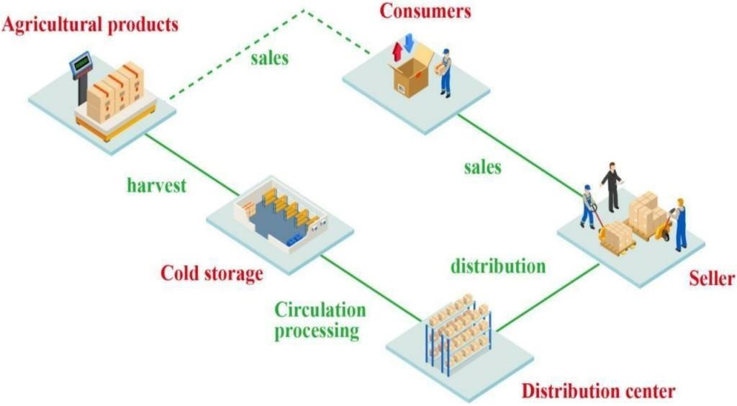
DB DESIGN

Slide 17
FLOW CHART

Slide 18
IMPLEMENTATION
Step 1: Data Collection
Step 2: Data Preprocessing
Step 3: Exploratory Data Analysis (EDA)
Step 4: Model Development Data Splitting
Step 5: Model Comparison

Slide 19
ALGORITHM
Data Processing
Train Lasso Regression Model
Train Linear Regression Model
Train Ridge Regression Model
Model Comparison and Selection

Slide 20
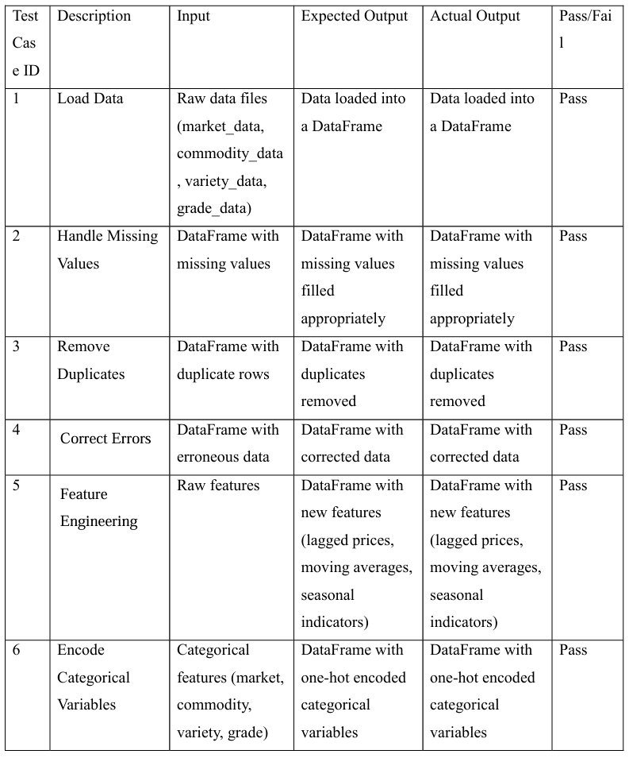
TESTING

Slide 21
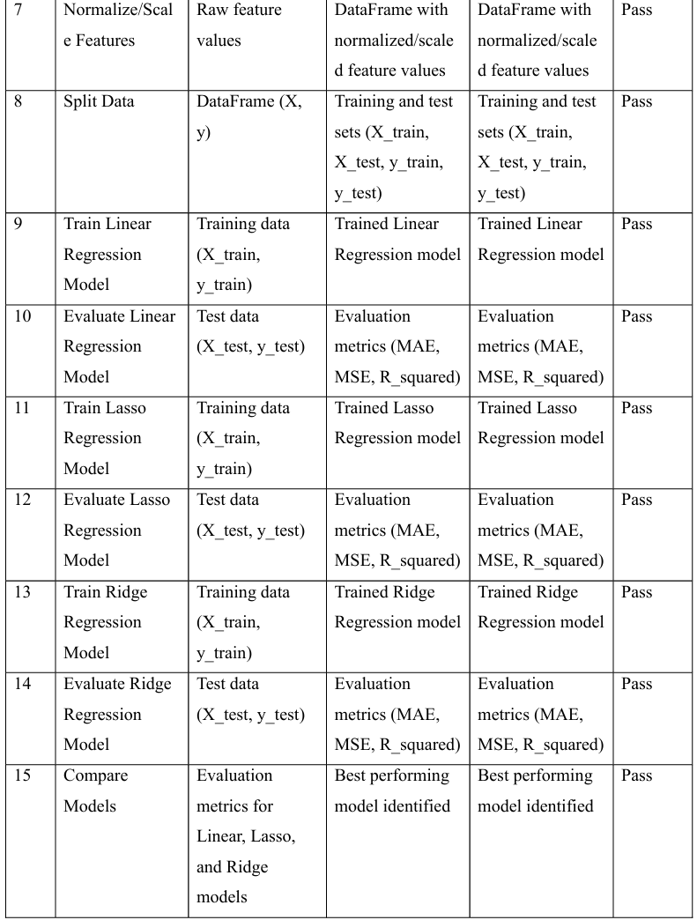

Slide 22
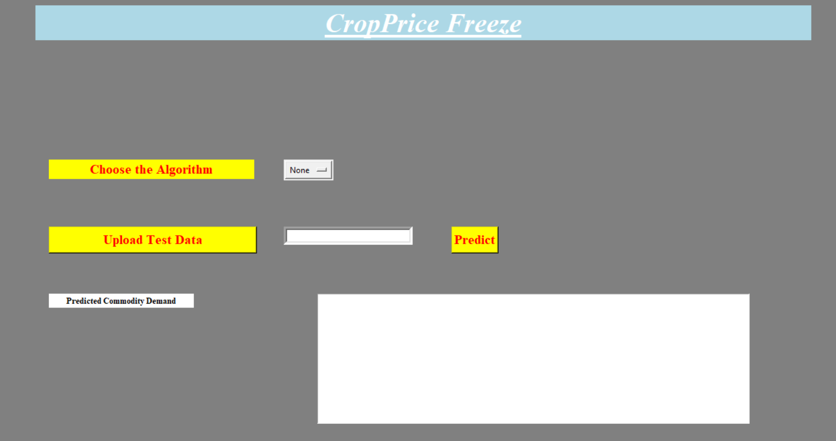
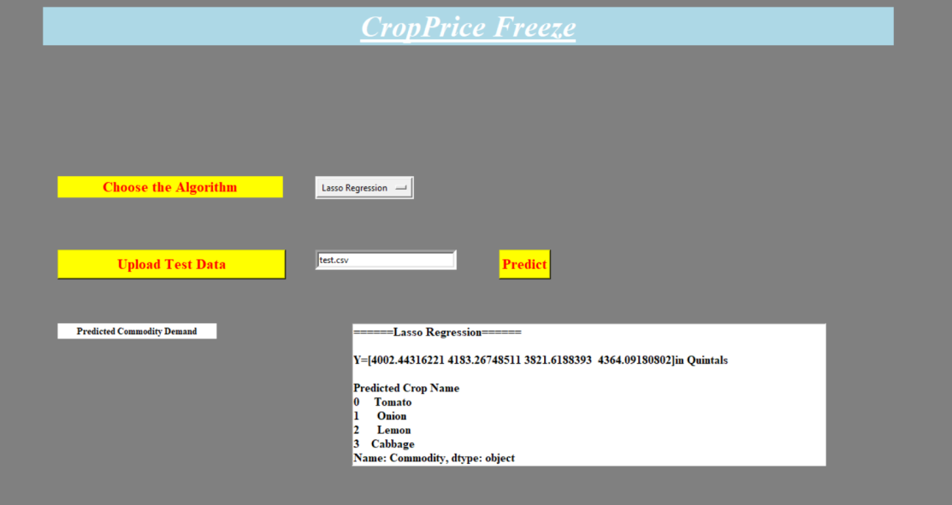
RESULTS AND SNAPSHOTS
Fig 1.1 CropPrice Freeze
Fig 1.2 Choosing Lasso Regression Algorithm

Slide 23
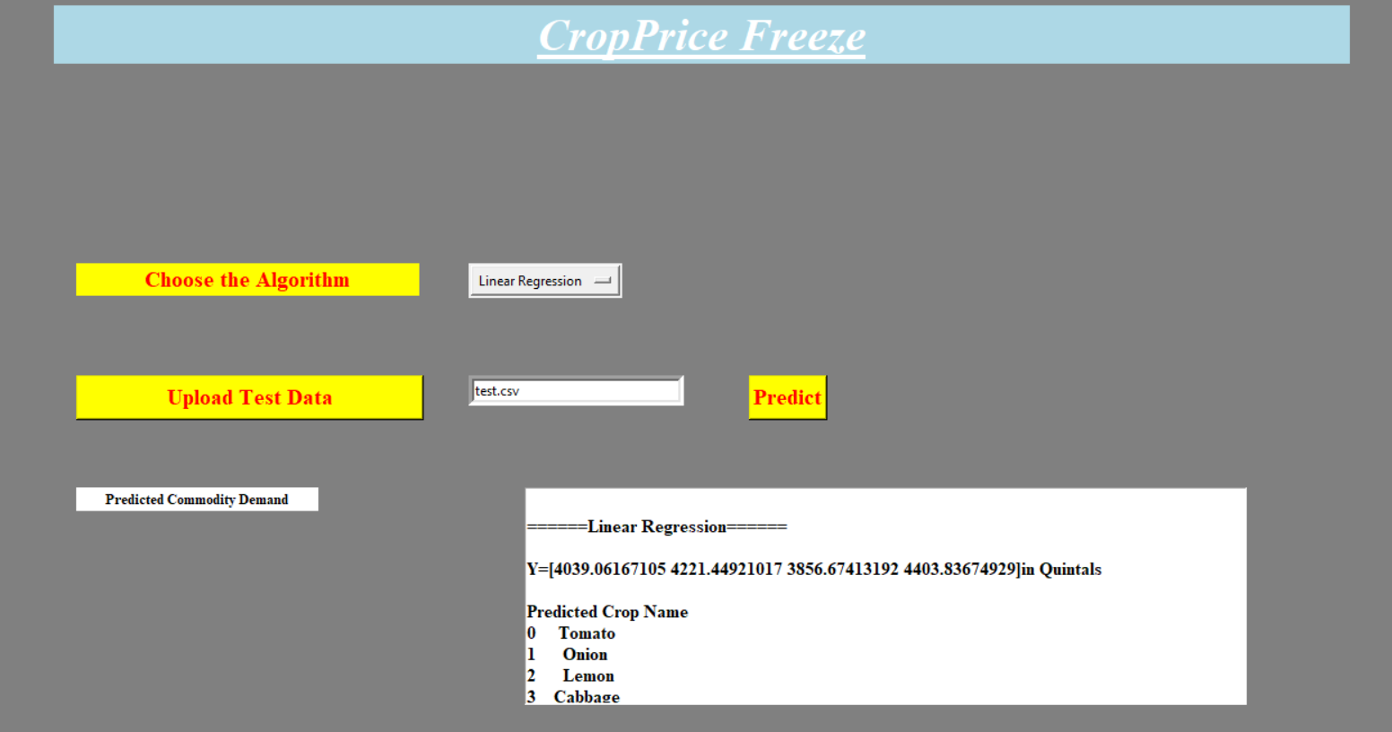
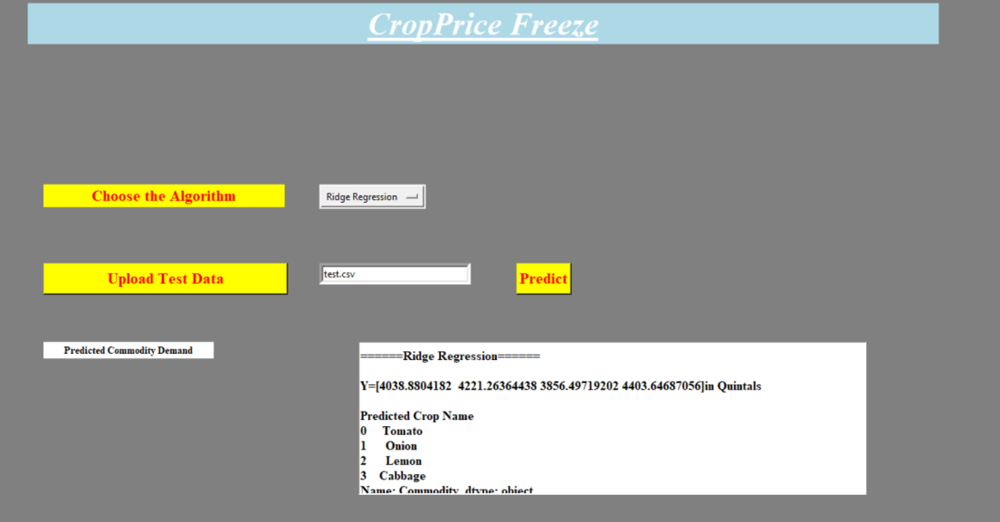
Fig 1.3 Choosing Linear Regression Algorithm
Fig 1.4 Choosing Ridge Regression Algorithm

Slide 24
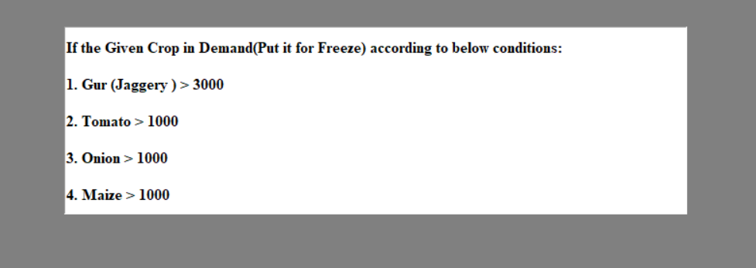
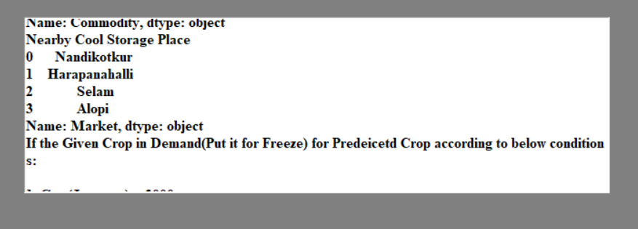
Fig 1.5 Put it for Freeze
Fig 1.6 Navigating Near By Cold Storage

Slide 25
CONCLUSION
In conclusion, the proposed system presents a transformative approach to address critical challenges within the agricultural supply chain.
The system aims to revolutionize both cold storage management and farmer empowerment, fostering sustainability, efficiency, and economic empowerment in the agricultural sector.
The integration of smart technologies enhances the overall efficiency of the cold storage facilities, ensuring the preservation of agricultural produce while reducing wastage and losses.

Slide 26
FUTURE ENHANCEMENGT
Future enhancements in AI-powered storage management for farmers could include advanced algorithms that analyze historical data to optimize storage capacity, predict inventory levels.
Furthermore, AI-powered storage management systems could incorporate machine learning capabilities to learn from farmer behavior and adapt to changing market demands, allowing farmers to make data-driven decisions about inventory management and supply chain logistics.
This could ultimately lead to cost savings, increased profitability, and a more sustainable farming practice.

Slide 27
REFERENCES
[1] S. Moghana Lavanya, K. Mahendran. (2020). Analysis of Cold Storage Capacity Utilization with Specific Reference to a Farmers Market in Tamil Nadu.
[2] Sudhanshu Joshi . (2020). Assessing the Readiness of Farmers Towards Cold Chain Management: Evidences From India.
[3] Fang Qiu ,Qifan Hu and Bing Xu. (2020). Fresh Agricultural Products Supply ChainCoordination and Volume Loss Reduction Based on Strategic Consumer.

Slide 28
[4] Shukla, M., & Jharkharia, S. (2013). Agri‐fresh produce supply chain management: A state‐of‐the‐art literature review. International Journal of Operations & Production Management.
[5] Shewfelt, R. L., Prussia, S. E., & Sparks, S. A. (2014). Challenges in Handling Fresh Fruits and Vegetables.
[6] Duiven, J. E. & Binard, P. (2002). Refrigerated Storage: New Developments. International Institute of Refrigeration.
[7] James, S. J., Evans, J., & James, C. (2008). A review of the performance of domestic refrigerators.

Slide 29
[8] Yu, Y.; Xiao, T. (2017). Pricing and cold-chain service level decisions in a fresh Agri-products supply chain with logistics outsourcing.
[9] Xiao, T.; Feng, Z. (2020). Price and cold-chain service decisions versus integration in a fresh Agri-product supply chain with competing retailers.
[10] Gu, B.; Fu, Y.; Li, Y. (2018). Fresh-keeping effort and channel performance in a fresh product supply chain with loss-averse consumers’ returns.

Slide 30
[11] Cai, X.; Chen, J.; Xiao, Y.; Xu, X.(2010). Optimization and coordination of fresh product supply chains with freshness-keeping effort.
[12] Mohammadi, H.; Ghazanfari, M.; Pishvaee, M.S.; Twimoury, E. (2019). Fresh-product supply chain coordination and waste reduction using a revenue and preservation-technology-investment-sharing contract.

Slide 31
THANK YOU

